Slide 1
High PV Injection on Distribution Feeders
Team Members:
Advisor: Dr. Venkataramana Ajjarapu
Shane Thompson
Alec Walczak
Brad Bender
Joe Near
Kiran Rane
Industry Client:
Notes:
Brad

Slide 2
Outline
Problem Statement
Background Information on PV Generation
Iowa
Issues
Development Process
Research Study
Analysis and Solution
Distribution Feeder Level
PV Generation Level
Cost Analysis
Challenges
Technical
Legal
Questions
Works Cited
Notes:
Brad

Slide 3
Problem Statement
Alternate and private forms of generation are becoming popular against the traditional utility provider. With growth of this secondary market, the power companies are observing a new phenomena in which utility owned equipment must be able to tolerate these new forms of green energy.
Most utilities are finding that they are having increased difficulty meeting these changes with their aging infrastructure, especially as interest in “net zero§” consumption increases.
Notes:
Brad
Alternate and private forms of energy are emerging rapidly in Iowa
With the growth of this secondary market utility owned equipment must be able to tolerate new forms of energy generation Most utilities are having issues meeting these changes with their aging infrastructure, specifically as interest in “Net Zero” consumption increases

Slide 4
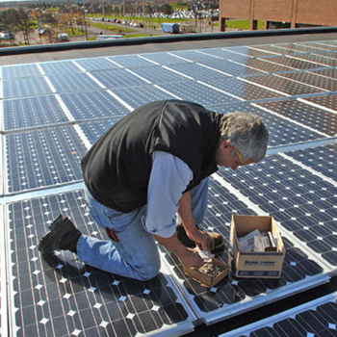
Renewables Market in Iowa
23rd among U.S. states in percentage of electricity that is solar generated as of 2014
16th in technical potential for PV energy production
Contains potential to build enough solar power for 500 million homes
Image Courtesy of Buffalo.edu
Notes:
Brad
Currently Iowa is 23rd among the US in % of electricity generated via solar
Iowa is 16th in technical potential in energy production
In all, we have a rapidly growing interest and market growing in Iowa that demands we look at this rapidly changing feild.

Slide 5
Issues Caused by Grid Connect PV Injection
In-Rush Current
Caused by difference in voltages between grid and PV system
Can cause nuisance tripping of grid protection devices
Thermal stress on components of the system
Voltage Issues
PV systems operate near unity PF (injects only active power into the grid)
Grid buses close to DG can have increased voltages due to decrease in reactive power
Notes:
Shane

Slide 6
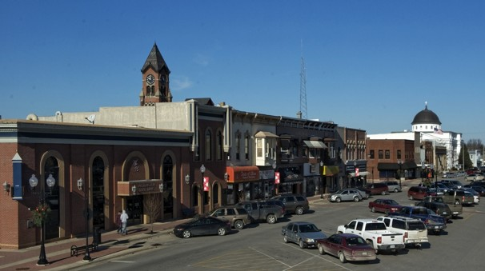
Washington, Iowa
35 miles South of Iowa City, IA
Population: 7,370
Approximate Customers
General Customer: 567
PV Customers: 56
Highest Concentration of Residential solar in the entire Alliant service area
Downton photo overlooking the main square.
Source: Courtesy of eastern-iowa.com
Notes:
Brad

Slide 7
Development Process
Research and Distribution Study
Previous semester’s work
Transition from IEEE Test Model to Real World Model
Distribution Study and Results
Analysis and Solution
Explore Solutions
Determine best solution based on cost and functionality
Notes:
Alec

Slide 8
IEEE 13 Bus Distribution Feeder
Test model to represent a distribution system
13 bus feeder
Small-scale starting point
Assumptions
Turned off the voltage regulator to note initial PV issues during simulations
Capacitors at nodes 611 and 675 were left on during testing
Transformer at line 633-634 is a step-down with an approximate 8:1 ratio
The “switch” at node 692 is closed for all simulations
Notes:
Joe – Use funny anecdote about IEEE code

Slide 9
Alliant Energy Project
Take real world data design a solution that could be implemented today with adaptations for future installment
Study and find way to prevent future problems
Find the optimal solution(s) that would benefit Alliant and their customers specifically those on rural feeders
Notes:
Joe

Slide 10
Resources
Alliant Energy
Darin Lamos – Alliant Energy liaison, providing
Guidance and insight
Customer data
Common utility software to analyze distribution.
Synergi Electric
Uses number of customers rather than number of nodes
Consistent modeling at 13.2 kV
Uses nominal residential voltage levels (120V/240V)
Notes:
Alec

Slide 11
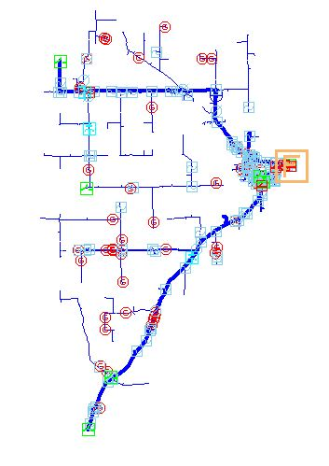
Distribution Study – Base Case
Snapshot Simulations
High solar generation and low power demand
One Substation with four feeders
Distribution voltage level: 13.2 kV
Peak Generation occurs between 10 am and 2 pm
Load: 1250 kW
Solar DG: 870 kW
Notes:
Joe

Slide 12
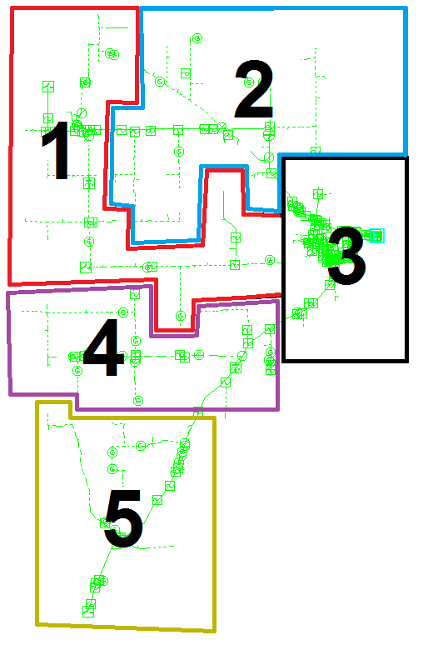
Distribution Study – Increased Solar Loading
Feeder broken into five regions based on number of customers
Each subsequent case has 100 kW of DG added
20 kW added to each region
Added DG to all regions at the same time for accurate load distribution
Notes:
Joe

Slide 13
Distribution Study - Results
Model Name | Total Solar (KW) | Solar PV/ Load Demand | % of Grid Over Voltage Limit
Base Case | 868.45 | 0.69476 | 5.54%
First Case | 968.45 | 0.77476 | 7.46%
Second Case | 1068.45 | 0.85476 | 11.23%
Third Case | 1168.45 | 0.93476 | 18.60%
Fourth Case | 1268.45 | 1.01476 | 21.47%
Notes:
Joe/Alec
It’s over 5% @ the generator due to xfmer loss

Slide 14
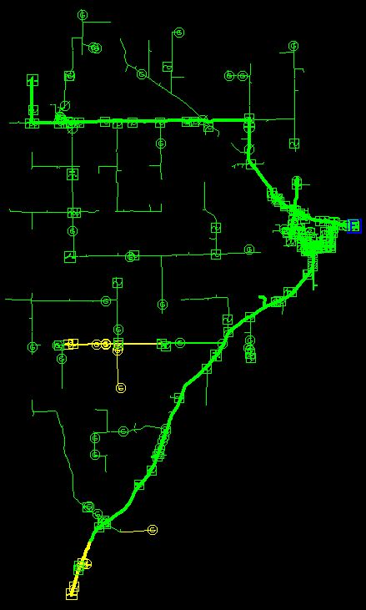
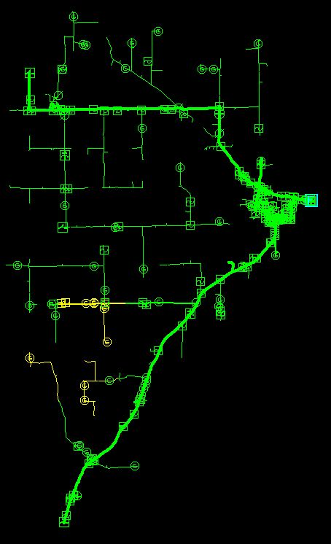
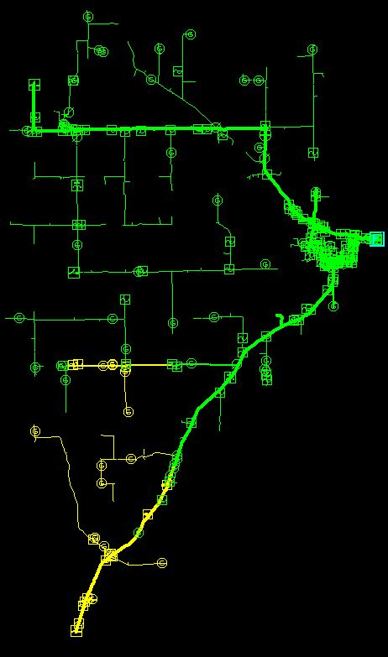
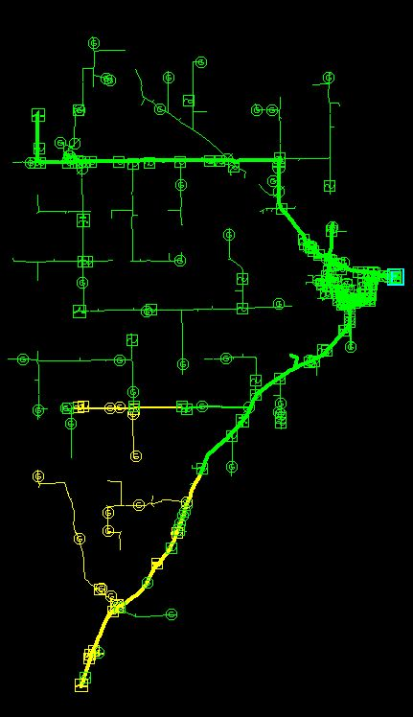
Distribution Study - Results
Case Four
Nominal
Case One
Case Two
Case Three
Over Voltage
Notes:
Joe

Slide 15
Solution Approaches
Distribution Feeder Level PV Generation Level
Notes:
Shane

Slide 16
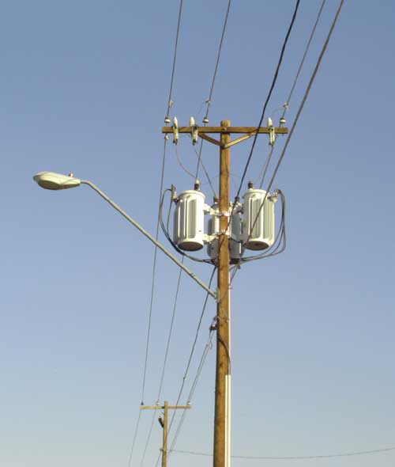
Distribution Feeder
Current lines run at 13.2 kV, upgrading the system to 24.9 kV will significantly increase rated capacity and limit damage.
Significant cost to Alliant to make these upgrades
Additional expansion may be needed sooner rather than later.
Notes:
Shane

Slide 17
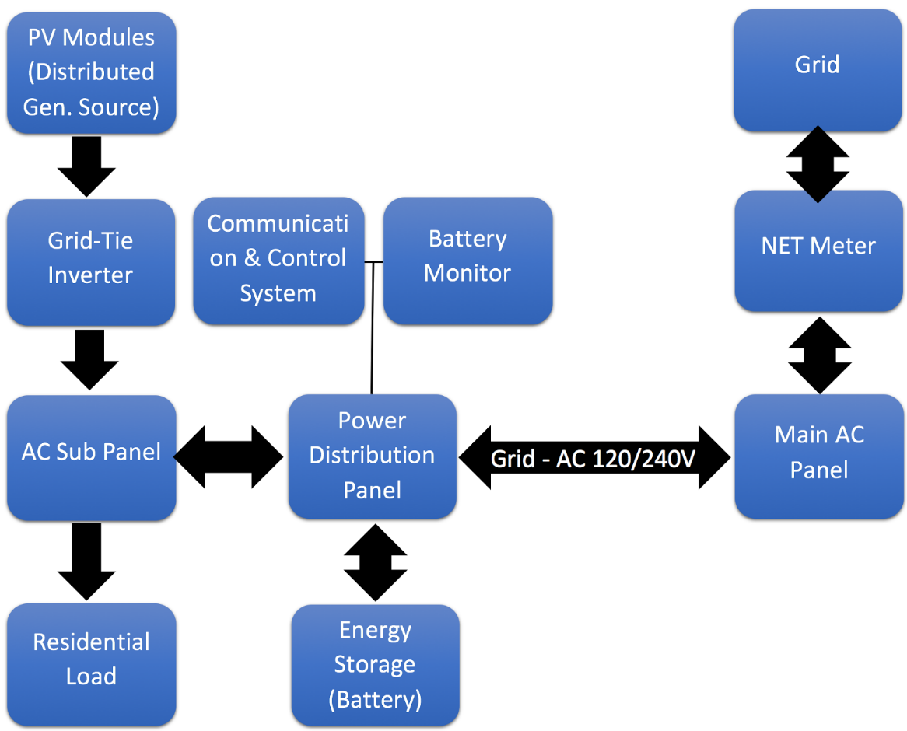
Residential PV Generation Level
Grid-Tie Inverter Solution with / without Backup Power
Proper inverter selection should include the following:
Reasonable cost
Low maintenance with high reliability
Optimal operating temperature for maximum efficiency
Ability to expand with future growth
Notes:
Kiran

Slide 18
Residential PV Generation
Considerations for Inverters
Frequency Protection/Tolerance
Must meet interconnection requirements
FERC/NERC Compliant
Must Meet IEEE-1547-2003 Standard
Setting configuration must be done by certified technician/electrician in accordance with Alliant standards
Notes:
Shane/Kiran
IEEE – 1547 – 2003 Requirement is intended to:
Prevent Damaging Phase-to-ground voltages that may exist in unintentional islands after the island forms but before it is detected and de-energized by the DR. (AKA anti-islanding)
Prevent excessive desensitization of the area EPS ground-fault detection device
Facilitate detection of area EPS faults by the DR
Islanding – a condition in which a DG (DR) continues to power a location even though electrical grid power from the utility is no longer present.

Slide 19
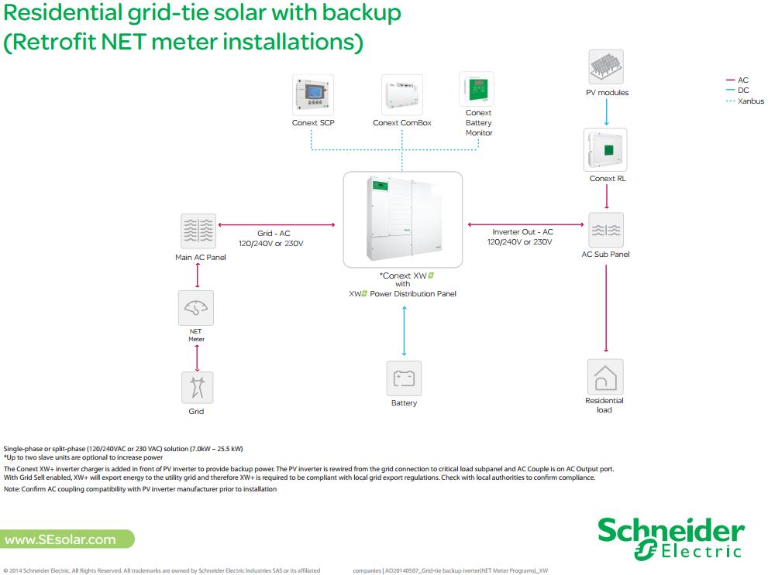
Residential PV Generation Level
Hybrid Inverter Solution with or without Backup Power
Self-contained DC to AC inverter
Uses proprietary designs to add Reactive Power to adjust voltage levels, in order to optimize for export to utility
Battery Charger
Integrated AC transfer switch
Provides a true sine wave output
Grid-interactive feature
Enables time management and prioritizations of energy sources
Notes:
Kiran

Slide 20
Residential Generation
Type | Power Consumption | Number | Approx. Usage hrs/Day
LED TV | 0.1 | 2 | 4
Lights/Room | 0.1 | 4 | 2
Washer | 2.3 (each run) | 1 | 1
Dryer | 2.3 (each run) | 1 | 1
Dishwasher | 2.8 (each run) | 1 | 1
Fridge | 1.6/day | 1 | 24
Usage Estimates
The typical house uses about 2.2 kWh/day
Maximum can occur at about 13.2 kWh/day
Nine lead acid batteries, in series, would yield 120V at 40 Ah
Which totals 4.8kWh or one Tesla Powerwall Li+ battery.
Notes:
Brad
These usage estimates were napkin math worked out via the graphic in this slide.
The goal was to come up with an average amount of batteries needed to help a PV customer get through at least a power outage without the need for a generator.
From that we determined that we need at least 9, 12 V batteries at 40 Ah which would give about 4.8kWhs of storage from basic appliance usage.

Slide 21
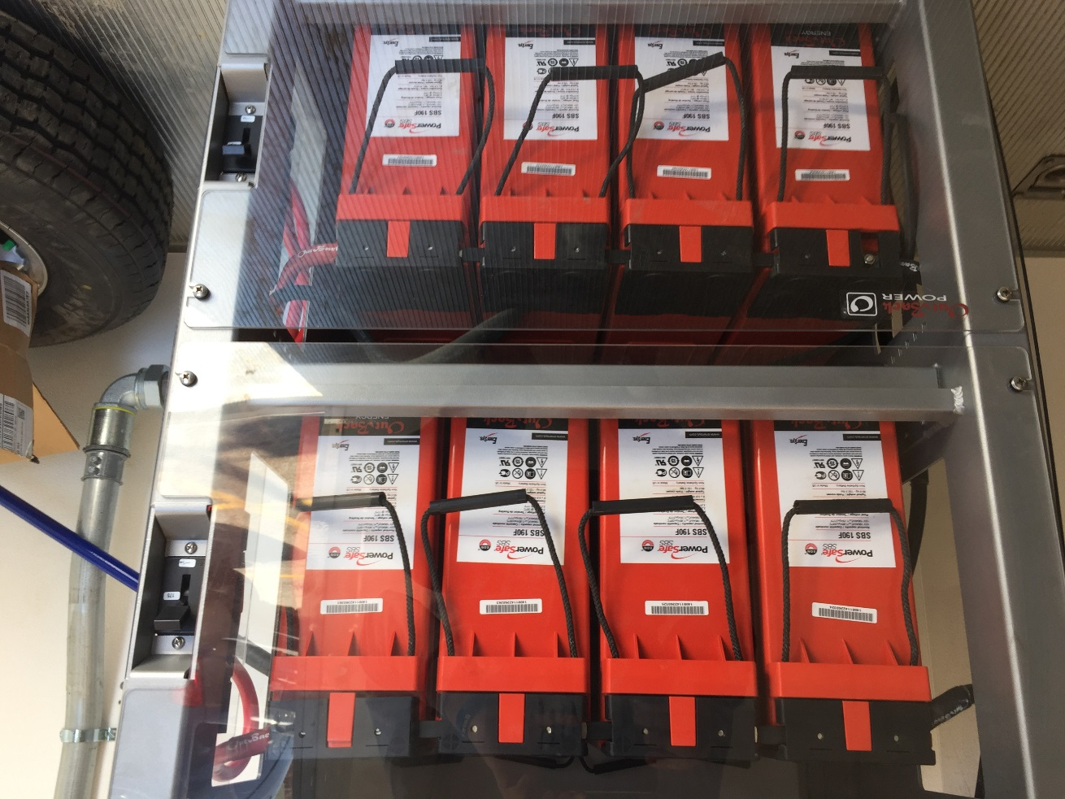
Residential PV Generation
Battery Storage
Lead Acid
PowerSafe SBS 190F by EnerSys
Cost effective in terms of Cost/Wh
Low Self-Discharge
Notes:
Brad
This is currently the traditional form of storage for PV. Lead Acid is a less expensive version of Li+ and is currently the most cost effective in terms of $/Wh
These batteries are also considered to have a low self-discharge overtime.

Slide 22
Residential PV Generation
Storage solution
Tesla Powerwall
Home battery storage up to 7kWh
A 10 kWh weekly cycle can be used for backup
Advertised as, “sufficient to power most homes during the evening.”
Batteries can be installed
Notes:
Kiran

Slide 23
Cost Analysis
 | Inverter with Battery | Upgrading Line
XW+ w/software | $3,200 | 100 circuit miles of single phase
Lead Acid Battery | ~$379 per battery | 20 circuit miles of 3 phase
x9 batteries = | $3,411 | Load tap substation transformer
 |  | 1 substation main circuit breaker
 |  | 4 feeder breakers
Total | $6,611 | $9,735,000
Return on Investment | $1,983.30 in federal tax credit + $180 per year in peak hour savings (based on Alliant billing statistics) | None
Notes:
Joe

Slide 24
Challenges
Technical:
Making transition from OpenDSS to Synergi
One laptop for a group of five to work with
Licensing issues that blocked acquisition of software to be used on more PCs.
Legal:
Coordinating between Iowa State & Alliant
Nondisclosure Agreement (NDA)
Intellectual Property (IP) Agreement
Notes:
Brad
Legal: These agreements were held up in arbitration for the majority of our two semesters to work on the project.
Thus, we didn’t get Alliant data until the last 5 weeks of the second semester
Technical: We had to coordinate laptop usage with limitations of on software license for synergi through Alliant
Because of this licensing issue we couldn’t have any of this software installed on ISU PC’s.
You may be wondering why we didn’t just chose to abandon this project with these issues. We saw ourselves as spear heading future teams to have power projects. There weren’t any projects to chose from at the time of our project selection.
Currently since the start of this, we have at least 2 others with potential for more in future semesters.

Slide 25
Questions?

Slide 26
Works Cited
Context XW Inverter/Charger. Rev J ed. Vol. 975-0239-01-01. Schneider Electric, 2015. PDF.
Ellis, Abraham. "Interconnection Standards for PV Systems Where Are We? Where Are We Going?" UVIG. Http://www.uwig.org/, 1 Oct. 2009. PDF. 1 Nov. 2015.
"IEEE Application Guide for IEEE Std 1547™, IEEE Standard for Interconnecting Distributed Resources with Electric Power Systems." IEEE Xplore. IEEE, 15 Apr. 2009. PDF. 31 Oct. 2015.
"Interstate Power and Light Electric Tariff." Alliant Energy. Alliant Energy, 21 Nov. 2013. PDF. 7 Dec. 2015.
"Introduction." Context XW Inverter/Charger. Revision F ed. Vol. 975-0240-01-01. Schneider Electric, 2015. 1-2. PDF.
"Powerwall, Tesla Home Battery." Tesla. Tesla. Web. 4 Dec. 2015.
"Residential Grid-tie Solar with Backup (Retrofit FIT Meter Installations)." SEsolar.com. Schneider Electric, 2014. PDF. 1 Nov. 2015.
"Residential Grid-tie." SEsolar.com. Schneider Electric, 2014. PDF. 1 Nov. 2015.
"Solar Energy." Iowa Environmental Council. Iowa Environmental Council. Web. 7 Dec. 2015.

Slide 27
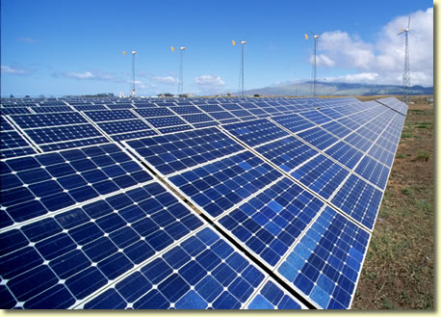
Issues with PV Generation
Power Flow Issues
Reverse power flow
Voltage beyond acceptable limits
Harmonic Issues
DC/AC Conversion
Notes:
Shane

